Slide 1
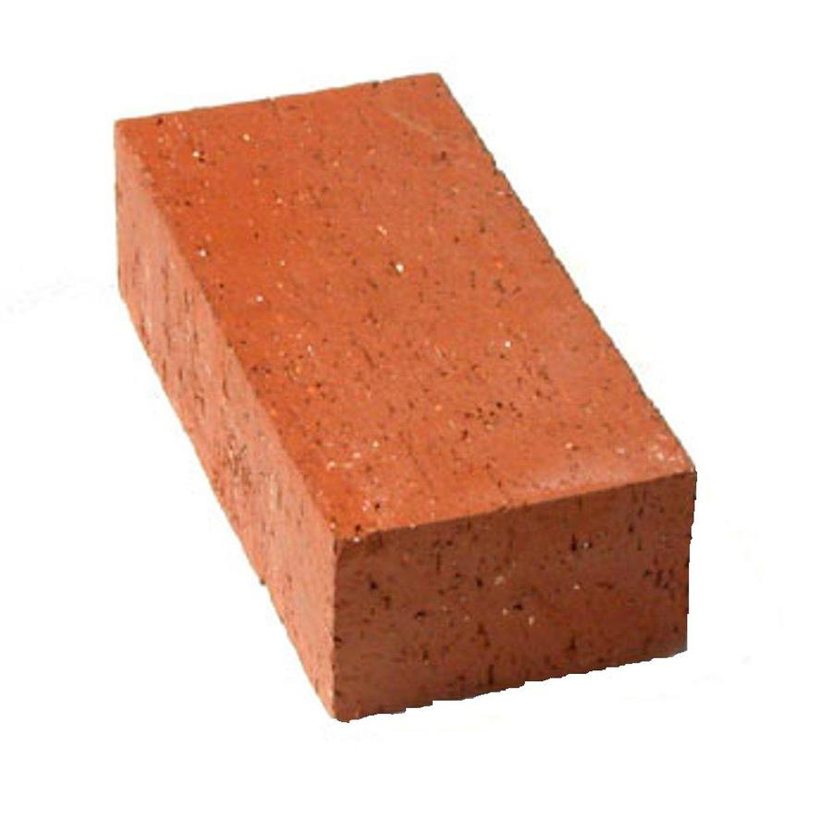
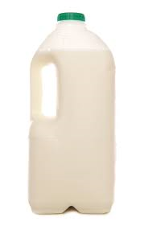
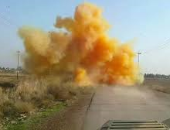
Daily Review
There are three main states of matter. They can be described in terms of volume, shape and compressibility.
Solids
Fixed volume
Fixed shape
Are incompressible
Liquids
Fixed volume
Variable shape
Are incompressible
Gases
Variable volume
Variable shape
Are compressible

Slide 2
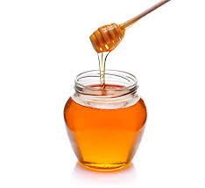
Daily Review
Steps for describing the state of matter
Step 1: Describe its shape (fixed or variable)
Step 2: Describe its volume (fixed or variable)
Step 3: Describe its compressibility (compressible or incompressible)
What state is honey?
Explain your decision using the terms volume, shape and compressible.
_________ is a _________ because it has a _________ shape, a _________ volume and is _______________.

Slide 3
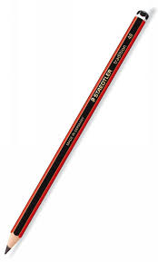
Daily Review
Steps for describing the state of matter
Step 1: Describe its shape (fixed or variable)
Step 2: Describe its volume (fixed or variable)
Step 3: Describe its compressibility (compressible or incompressible)
What state is a pencil?
Explain your decision using the terms volume, shape and compressible.
_________ is a _________ because it has a _________ shape, a _________ volume and is _______________.

Slide 4

Daily Review
Steps for describing the state of matter
Step 1: Describe its shape (fixed or variable)
Step 2: Describe its volume (fixed or variable)
Step 3: Describe its compressibility (compressible or incompressible)
What state is carbon dioxide?
Explain your decision using the terms volume, shape and compressible.
_________ is a _________ because it has a _________ shape, a _________ volume and is _______________.

Slide 5
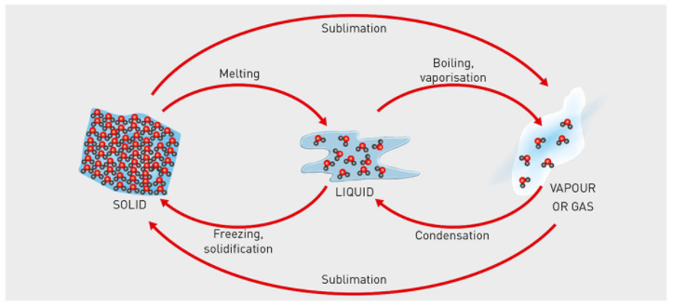
Concept Development
CFU 1
What three state changes involve an decrease in heat?
Substances can change between the three states by heating or cooling.
When substances are cooled, they lose energy.
When substances are heated, the gain energy.
INCREASING HEAT
CFU 2
What happens to the energy in a substance when it is cooled?
CFU 3
What is the phase change when a liquid becomes a solid?
Deposition
DECREASING HEAT

Slide 6
Skill Development/Guided Practice
CFU 1
What is the change of state?
Describing phase changes
Name the phase change.
Describe the change in energy (increase/decrease)
CFU 2
Is the energy increasing or decreasing?
Describe how a solid becomes a liquid.
INCREASING ENERGY
A solid becomes a liquid by _________.
The energy _______.
Deposition
DECREASING ENERGY

Slide 7
Skill Development/Guided Practice
CFU 1
What is the change of state?
Describing phase changes
Name the phase change.
Describe the change in energy (increase/decrease)
CFU 2
Is the energy increasing or decreasing?
Describe how a gas becomes a liquid.
INCREASING HEAT
A gas becomes a liquid by __________.
The energy _________.
Deposition
DECREASING HEAT

Slide 8
Types of mixtures

Slide 9
Learning Objective
CFU
What are we going to learn today?
Define a mixture
Identify different types of mixtures
Activate Prior Knowledge
Think, Pair, Share: Tell the person next to you when you have mixed two or more things together, either at home or at school.
Vocabulary
Define: describe the meaning of Identify: state and name different features.

Slide 10
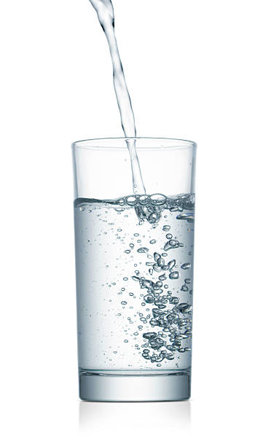
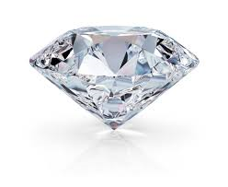
Concept Development
CFU 1
In your own words, what is a mixture?
What are mixtures?
Mixtures are a combination of two or more substances
Glass, plastic, tap water and milk are all mixtures
What are pure substances?
Pure substances are materials that are not combined with anything else
Pure water, oxygen and diamonds are pure substances
CFU 2
Name a mixture you have used today.
CFU 3
How is a mixture different to a pure substance?

Slide 11
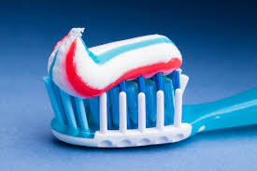
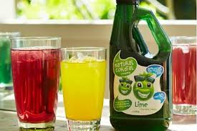
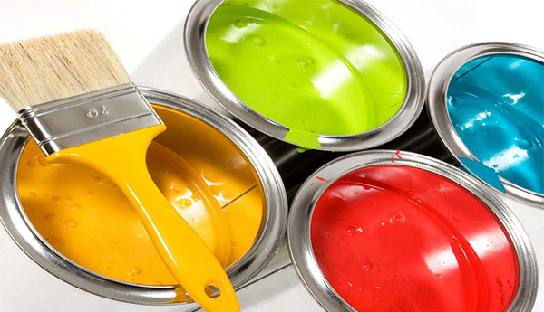
Concept Development
CFU 1
How do scientists group mixtures?
Properties of Mixtures
Different types of mixtures have different characteristics
Scientists group mixtures according to their characteristics, for example what they are made from and how they behave
CFU 2
Look at the three mixtures below. Which two are most similar? Explain your choice.
Vocabulary
Characteristics: feature or quality

Slide 12
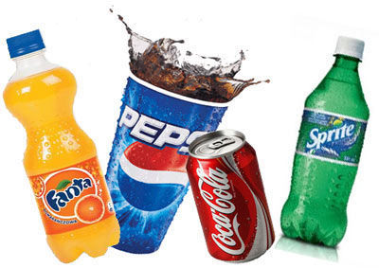
Concept Development
CFU 1
What is a solution?
Solutions
Solutions are mixtures where one substance is dissolved evenly throughout another
Solutions are usually transparent, you can see through them or shine a light through.
Salt water and soft drink are examples of solutions
CFU 2
How could you tell if a mixture is a solution?
CFU 3
Is a glass of cordial a solution? Why or why not?
Vocabulary
Transparent: see- through

Slide 13
Concept Development
CFU 1
How many types of solution are there?
Types of Solutions
Solid dissolved in a liquid
Liquid dissolved in a liquid
Gas dissolved in a liquid
Gas dissolved in another gas
Examples include
Salt dissolved in water
Detergent dissolved in water
Oxygen dissolved into blood
Carbon dioxide in air
CFU 2
Which type is a oil dissolved in petrol?
CFU 2
What is an example of a solid dissolved in a liquid solution?

Slide 14
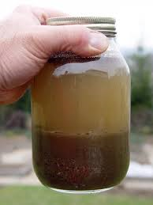
Concept Development
CFU 1
What is a suspension?
Suspensions
A suspension is a mixture where one substance is spread through another, but does not dissolve.
After a while, the heavier particles will settle to the bottom as sediment.
Dirty water is a solid in liquid suspension
Dust in the air is a solid in gas suspension
Oil paint is a liquid in liquid suspension
CFU 2
How could you tell if a mixture is a suspension?
CFU 3
How is a suspension different to a solution?
Vocabulary
Sediment: solids that settle to the bottom of a liquid

Slide 15
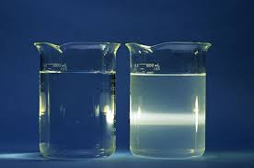
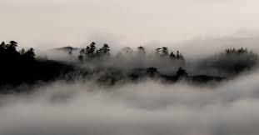
Concept Development
CFU 1
What is a colloid?
Colloids
A colloid is a suspension that does not separate over time
CFU 2
Which beaker is the colloid, left or right?
Colloids can be formed in different ways:
Acrylic paint is a solid suspended in a liquid
Fog is a liquid suspended in a gas
Milk is liquid suspended in a liquid
When light is shone through a colloid, a beam of light can be seen.
Vocabulary
Suspension: a cloudy liquid that separates over time

Slide 16
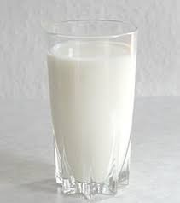
Skill Development/ Guided Practice
CFU 1
Is the substance dissolved or suspended?
Identifying a type of mixture.
1. Is one substance dissolved evenly = solution 2. Is one substance spread through out another? Will it settle out = suspension Will it stay suspended = colloid
CFU 2
What type of mixture is this?
Milk
Milk is a colloid because it is one substance suspended in another and will stay suspended.

Slide 17
Skill Development/ Guided Practice
CFU 1
Is the substance dissolved or suspended?
Identifying a type of mixture.
1. Is one substance dissolved evenly = solution 2. Is one substance spread through out another? Will it settle out = suspension Will it stay suspended = colloid
CFU 2
What type of mixture is this?
Tap water is a solution because it is one substance dissolved evenly in another.
Tap water

Slide 18
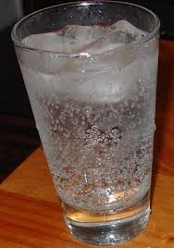
Skill Development/ Guided Practice
CFU 1
Is the substance dissolved or suspended?
Identifying a type of mixture.
1. Is one substance dissolved evenly = solution 2. Is one substance spread through out another? Will it settle out = suspension Will it stay suspended = colloid
CFU 2
What type of mixture is this?
Soft drink
Soft drink is a solution because it is one substance dissolved evenly in another.

Slide 19
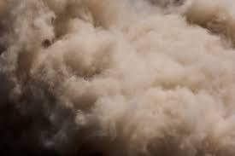
Skill Development/ Guided Practice
CFU 1
Is the substance dissolved or suspended?
Identifying a type of mixture.
1. Is one substance dissolved evenly = solution 2. Is one substance spread through out another? Will it settle out = suspension Will it stay suspended = colloid
CFU 2
What type of mixture is this?
Dust cloud
A dust cloud is a suspension because it is one substance suspended in another and it will settle out.

Slide 20

Skill Development/ Guided Practice
CFU 1
Is the substance dissolved or suspended?
Identifying a type of mixture.
1. Is one substance dissolved evenly = solution 2. Is one substance spread through out another? Will it settle out = suspension Will it stay suspended = colloid
CFU 2
What type of mixture is this?
Fog
Fog is a colloid because it is one substance suspended in another and it will stay suspended.

Slide 21
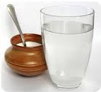
Skill Development/ Guided Practice
CFU 1
Is the substance dissolved or suspended?
Identifying a type of mixture.
1. Is one substance dissolved evenly = solution 2. Is one substance spread through out another? Will it settle out = suspension Will it stay suspended = colloid
CFU 2
What type of mixture is this?
Sugar in water
Sugar in water is a ______ because it is one substance _________in another.

Slide 22
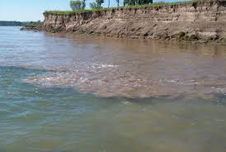
Skill Development/ Guided Practice
CFU 1
Is the substance dissolved or suspended?
Identifying a type of mixture.
1. Is one substance dissolved evenly = solution 2. Is one substance spread through out another? Will it settle out = suspension Will it stay suspended = colloid
CFU 2
What type of mixture is this?
Muddy water
Muddy water is a ______ because it is one substance _______ in another and it will ______.

Slide 23
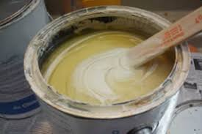
Skill Development/ Guided Practice
CFU 1
Is the substance dissolved or suspended?
Identifying a type of mixture.
1. Is one substance dissolved evenly = solution 2. Is one substance spread through out another? Will it settle out = suspension Will it stay suspended = colloid
CFU 2
What type of mixture is this?
Oil paints
Notes:
Oil paint is a liquid in liquid suspension. Because it is one substance suspended in another and will settle out.

Slide 24
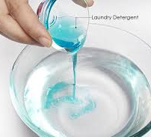
Skill Development/ Guided Practice
CFU 1
Is the substance dissolved or suspended?
Identifying a type of mixture.
1. Is one substance dissolved evenly = solution 2. Is one substance spread through out another? Will it settle out = suspension Will it stay suspended = colloid
CFU 2
What type of mixture is this?
Liquid detergent
Notes:
Liquid detergent is a colloid because it is one substance suspended in another and it will stay suspended.

Slide 25
Relevance
Mixtures are a combination of two or more substances
Knowing the types of mixtures will help you work out ways to separate them into pure substances

Slide 26
Skill Closure
What is a mixture?
Skill Closure
Match each of the mixtures below to its type (suspension, colloid, solution)
1 2 3 4
Skill Closure
What is one similarity and one difference between colloids and suspensions?

Slide 27
Independent Practice
Using your device, or in your book, answer the following questions.
1. Define the following
a) Solution
b) Suspension
c) Colloid
2. List four types of solution (_____ dissolved in _____) and give an example of each.
3. List three types of suspension (______ in ______) and give an example of each.
4. List three types of colloid (____ suspended in a _____)and give an example of each.
5. Classify the following as a solution, suspension or colloid.
Cordial in water, carbon dioxide in lemonade, clouds, food colouring in water, oil in salad dressing, egg white in a pavlova, dust in the air, smoke from a car exhaust.
6. Think of a common mixture and write it down, but don’t tell your partner. They will do the same. Think of a series of questions you could ask to identify the mixture.

